Slide 1
We are not afraid to die If we can all be together
Gordon Cook and Alan East

Slide 2
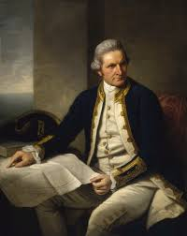
Captain James Cook
Captain James Cook FRS (7 November [O.S. 27 October] 1728– 14 February 1779) was a British explorer, navigator, cartographer, and captain in the British Royal Navy, famous for his three voyages in the Pacific and Australia in particular. He made detailed maps of Newfoundland prior to making three voyages to the Pacific Ocean, during which he achieved the first recorded European contact with the eastern coastline of Australia and the Hawaiian Islands, and the first recorded circumnavigation of New Zealand.

Slide 3
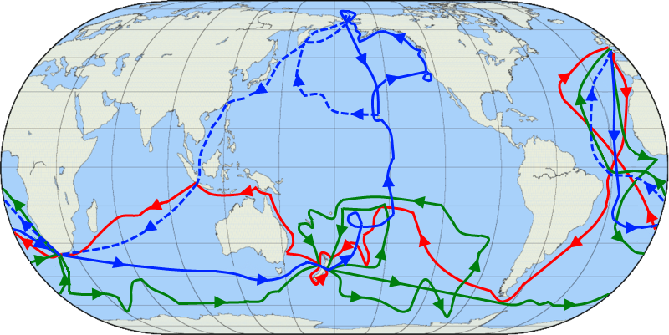
The routes of Captain James Cook's voyages. The first voyage is shown in red, second voyage in green, and third voyage in blue. The route of Cook's crew following his death is shown as a dashed blue line.

Slide 4
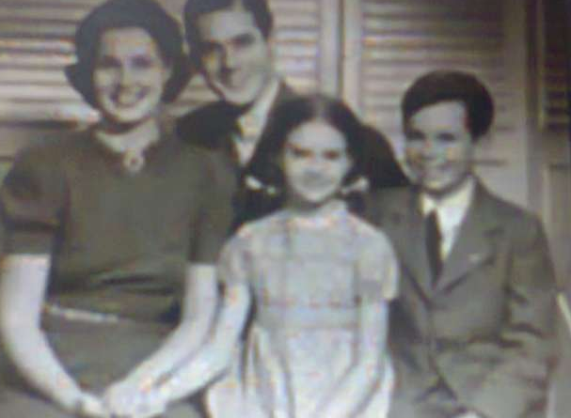
Characters
Narrator
Mary
Jonathan
Suzanne
Crewmen : Larry Vigil & Herb Seigler

Slide 5
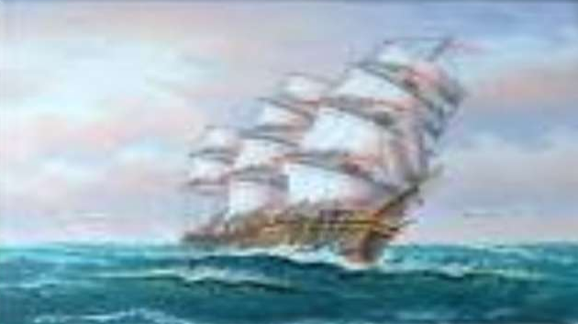
In July 1976, they sailed for journey to world voyage. They tried to duplicate the round the world voyage made 20 year earlier by Captain James Cook in their professionally built ship - The WAVEWALKER.

Slide 6
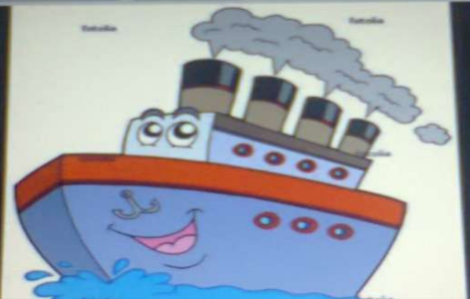
First Leg of the Journey
They pleasantly sailed down from west coast of africa to cape town.
Then further they sailed to southern Indian ocean.

Slide 7
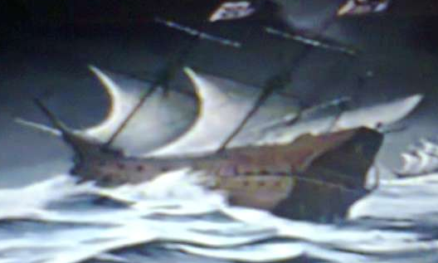
Firsts signs of disaster
They encountered strong winds on second day of leaving Cape Town and this disaster was continued for few weeks.
This was so disastrous that waves rised as high as 15 metres above the mast.

Slide 8
The disaster and its aftermath
By 6PM, tremendous explosions shock the deck and powerful flow of water broke over the ship.
WaveWalker was dramatically sinking and the captain was badly injured.
Captain kept courage and found the wheel and lind up the stern for next wave.

Slide 9
Effect of the Storm and waves
Water level inside the ship rose threateningly
Electric pump system short-circuited
Suzanne was injured
The starboard and supporting structure of the boat was heavily damaged

Slide 10
Crewmen show unparalleled courage
The crewmen ( Larry Vigil & Herb Seigler) started pumping out water and settled to make necessary repairs to save the boat from sinking.
They managed to stretch canvas and secure water-proof hatch cover across gaping holes.

Slide 11
Exemplary courage of children
The optimistic attitude of the children of NOT BEING AFRAID TO DIE IF THEY CAN BE TOGETHER even when Sue had a bumped head and Jonathan was terribly scared boosted the morale of the narrator

Slide 12
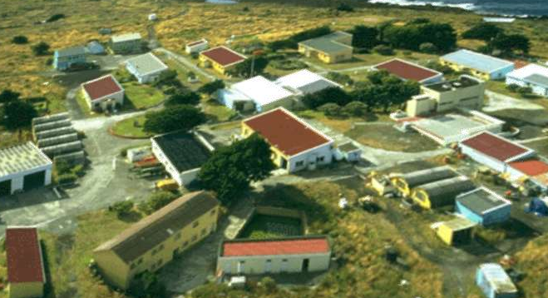
ILE AMSTERDAM

Slide 13
What can we learn?
Humans have a nature of knowing, assessing and taking on challenges.
Our instinct simply helps us do difficult things but deep within, we get scared sometimes.
It is in these times when we need to exhibit the level of courage Jonathan and Sue did, even being little children.

